Slide 1

CS123 Digital Logic Design
LECTURE 06
The Karnaugh Map
Engr.Hammad Munami

Slide 2
Introduction
A Karnaugh map provides a systematic method for simplifying Boolean expressions and, if properly used, will produce the simplest SOP or POS expression possible, known as the minimum expression.
A Karnaugh map is similar to a truth table because it presents all of the possible values of input variables and the resulting output for each value.
Instead of being organized into columns and rows like a truth table, the Karnaugh map is an array of cells in which each cell represents a binary value of the input variables.
Engr.Hammad Munami

Slide 3
Introduction
The cells are arranged in a way so that simplification of a given expression is simply a matter of properly grouping the cells.
The number of cells in a Karnaugh map, as well as the number of rows in a truth table, is equal to the total number of possible input variable combinations.
For three variables, the number of cells is 2³ = 8.
For four variables, the number of cells is 2⁴ = 16.
Engr.Hammad Munami

Slide 4
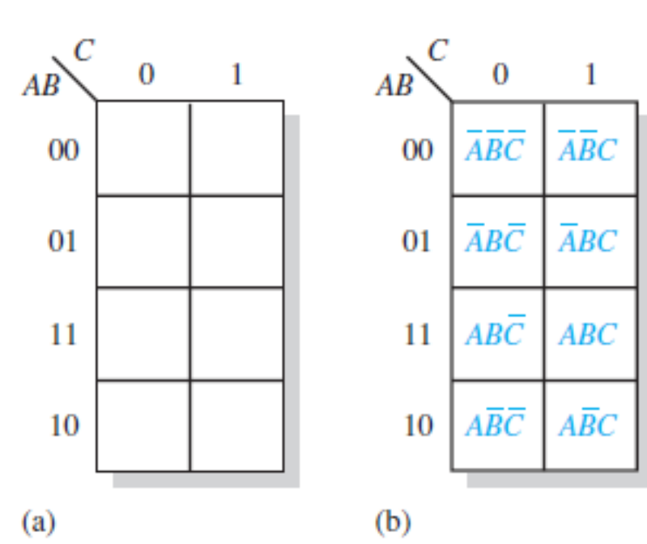
The 3-Variable Karnaugh Map
The 3-variable Karnaugh map is an array of eight cells (2³).
Engr.Hammad Munami

Slide 5
Point to be Noted…
In case of K-maps the row and column differ by a single bit i.e. to write numerically the index it is (00 01 11 10) as we move along, there is a change of only one bit and this is the functionality of Gray code.
Cells that differ by only one variable are adjacent.
Cells with values that differ by morethan one variable are not adjacent.
Engr.Hammad Munami

Slide 6
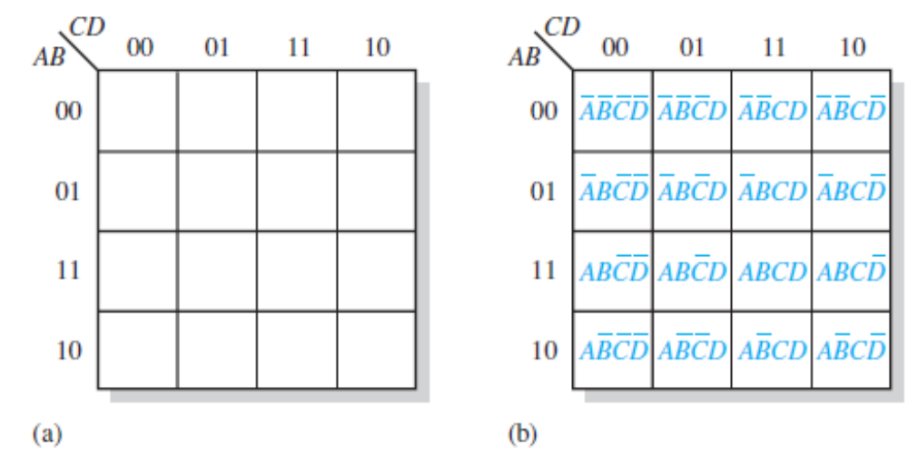
The 4-Variable Karnaugh Map
The 4-variable Karnaugh map is an array of sixteen cells.
Engr.Hammad Munami

Slide 7
Wrap-around Adjacency
Physically, each cell is adjacent to the cells that are immediately next to it on any of its four sides.
A cell is not adjacent to the cells that diagonally touch any of its corners.
Also, the cells in the top row are adjacent to the corresponding cells in the bottom row and the cells in the outer left column are adjacent to the corresponding cells in the outer right column.
This is called “wrap-around” adjacency because you can think of the map as wrapping around from top to bottom to form a cylinder or from left to right to form a cylinder.
Engr.Hammad Munami

Slide 8
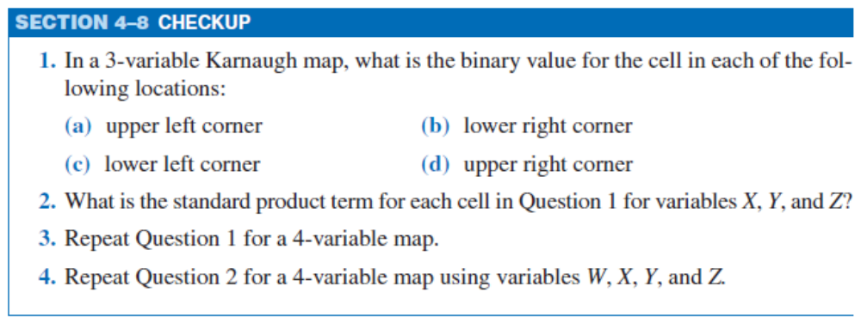
DIY
Engr.Hammad Munami

Slide 9
Karnaugh Map SOP Minimization
The Karnaugh map is used for simplifying Boolean expressions to their minimum form.
A minimized SOP expression contains the fewest possible terms with the fewest possible variables per term.
Generally, a minimum SOP expression can be implemented with fewer logic gates than a standard expression.
Engr.Hammad Munami

Slide 10
Mapping a Standard SOP Expression
For an SOP expression in standard form, a 1 is placed on the Karnaugh map for each product term in the expression.
Each 1 is placed in a cell corresponding to the value of a product term.
For example, for the product term ABC, a 1 goes in the 101 cell on a 3-variable map.
When an SOP expression is completely mapped, there will be a number of 1s on the Karnaugh map equal to the number of product terms in the standard SOP expression.
The cells that do not have a 1 are the cells for which the expression is 0.
Engr.Hammad Munami

Slide 11
Mapping a Standard SOP Expression
Usually, when working with SOP expressions, the 0s are left off the map.
Following steps to be followed when mapping a standard SOP expression:
Step 1: Determine the binary value of each product term in the standard SOP expression.
After some practice, you can usually do the evaluation of terms mentally.
Step 2: As each product term is evaluated, place a 1 on the Karnaugh map in the cell having the same value as the product term.
Engr.Hammad Munami

Slide 12
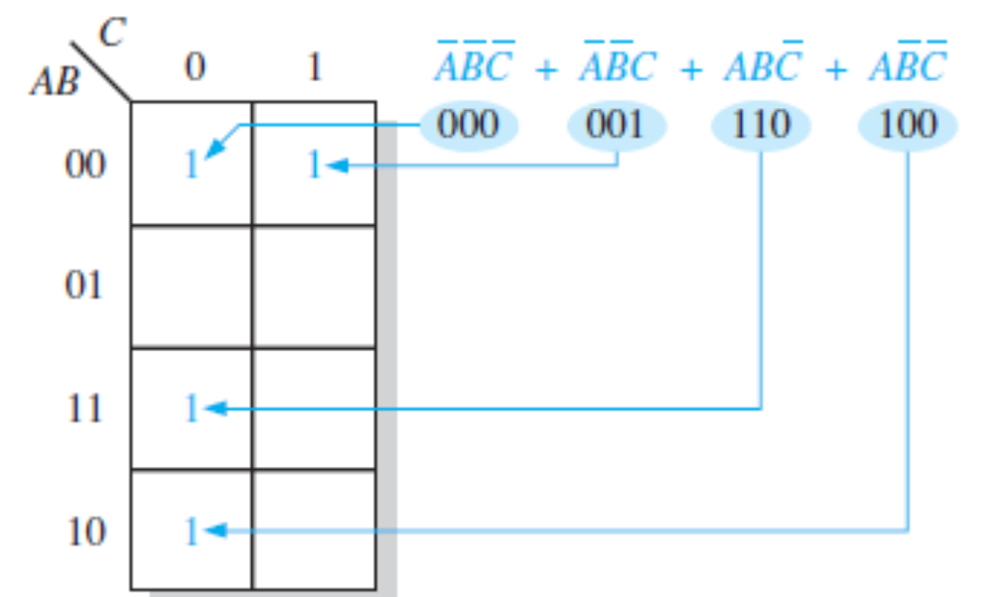
Mapping a Standard SOP Expression
Engr.Hammad Munami

Slide 13
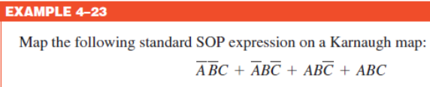
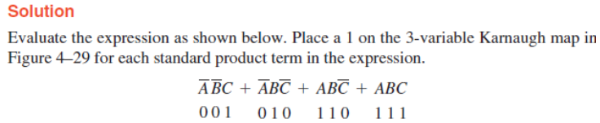
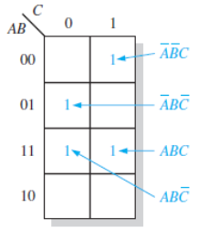
Engr.Hammad Munami

Slide 14
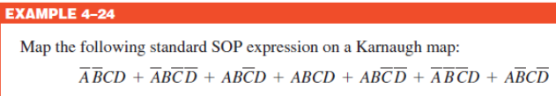
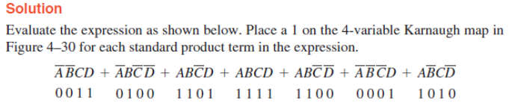
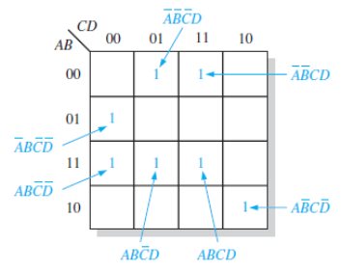
Engr.Hammad Munami

Slide 15

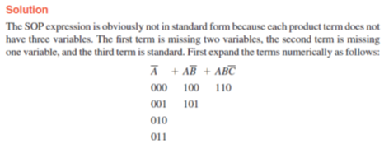
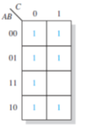
Mapping a Nonstandard SOP Expression
Engr.Hammad Munami

Slide 16
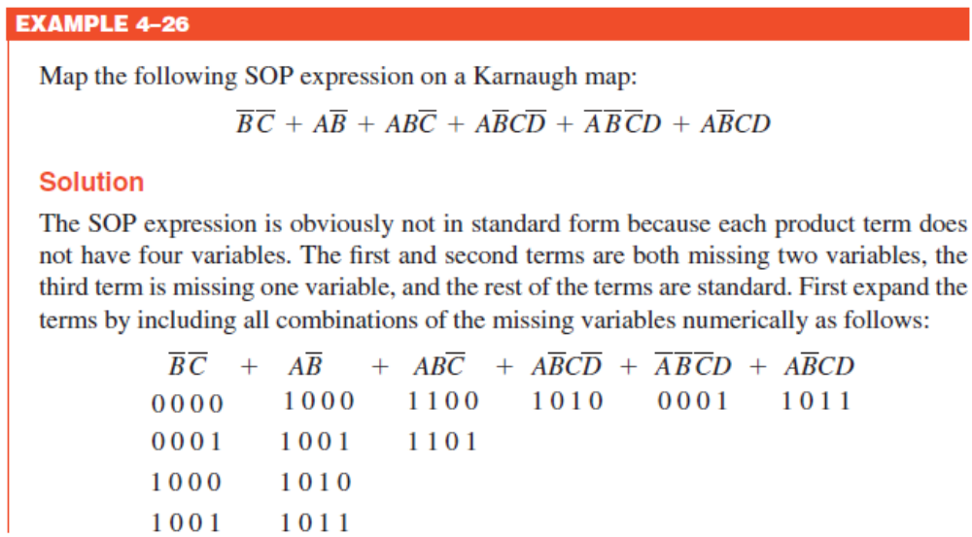
Engr.Hammad Munami

Slide 17
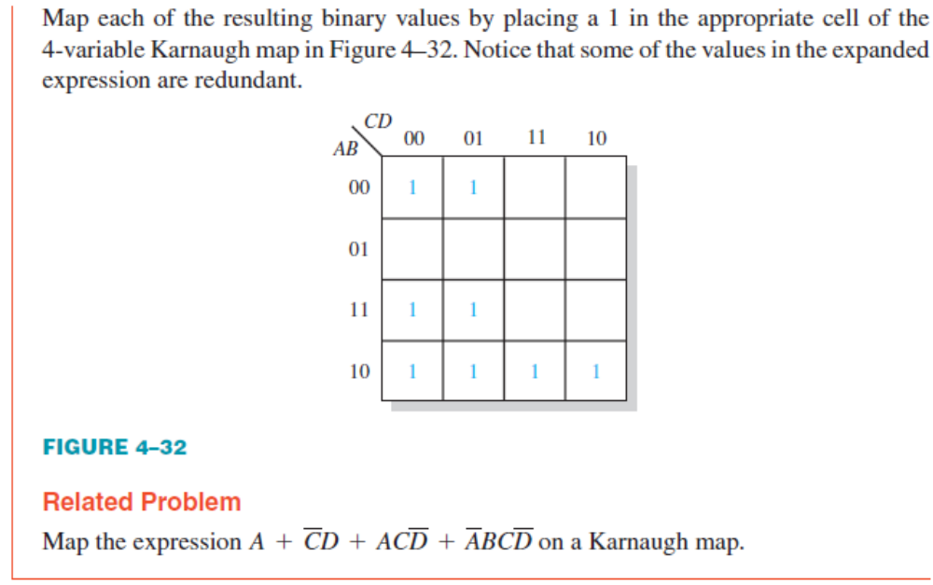
Engr.Hammad Munami

Slide 18

DIY
Engr.Hammad Munami

Slide 19
Karnaugh Map Simplification of SOP Expressions
The process that results in an expression containing the fewest possible terms with the fewest possible variables is called minimization.
After an SOP expression has been mapped, a minimum SOP expression is obtained by grouping the 1s and determining the minimum SOP expression from the map.
Engr.Hammad Munami

Slide 20
Grouping the 1s
The goal is to maximize the size of the groups and to minimize the number of groups.
You can group 1s on the Karnaugh map according to the following rules by enclosing those adjacent cells containing 1s.
Rule 1: A group must contain either 1, 2, 4, 8, or 16 cells, which are all powers of two.
In the case of a 3-variable map, 2³ = 8 cells is the maximum group.
Rule 2: Each cell in a group must be adjacent to one or more cells in that same group, but all cells in the group do not have to be adjacent to each other. (Continue…)
Engr.Hammad Munami

Slide 21
Grouping the 1s
Rule 3: Always include the largest possible number of 1s in a group in accordance with rule 1.
Rule 4: Each 1 on the map must be included in at least one group.
The 1s already in a group can be included in another group as long as the overlapping groups include noncommon 1s.
Engr.Hammad Munami

Slide 22
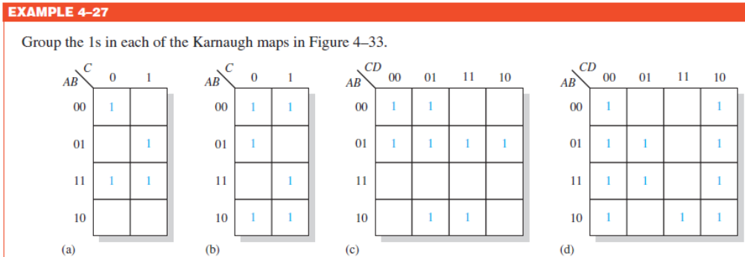
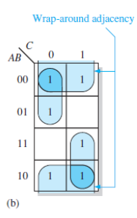
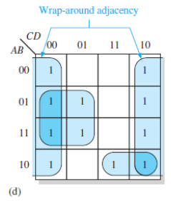
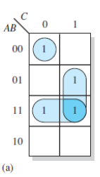
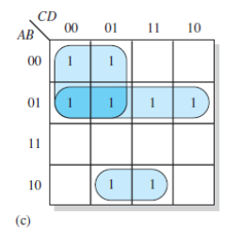
Engr.Hammad Munami

Slide 23
Determining the Minimum SOP Expression from the Map
When all the 1s representing the standard product terms in an expression are properly mapped and grouped, the process of determining the resulting minimum SOP expression begins.
The following rules are applied to find the minimum product terms and the minimum SOP expression:
Rule 1: Group the cells that have 1s. Each group of cells containing 1s creates one product term composed of all variables that occur in only one form (either uncomplemented or complemented) within the group.
Variables that occur both uncomplemented and complemented within the group are eliminated.
These are called contradictory variables. (Continued…)
Engr.Hammad Munami

Slide 24
Rule 2: Determine the minimum product term for each group.
(a) For a 3-variable map:
  (i) A 1-cell group yields a 3-variable product term
  (ii) A 2-cell group yields a 2-variable product term
  (iii) A 4-cell group yields a 1-variable term
  (iv) An 8-cell group yields a value of 1 for the expression
(b) For a 4-variable map:
  (i) A 1-cell group yields a 4-variable product term
  (ii) A 2-cell group yields a 3-variable product term
  (iii) A 4-cell group yields a 2-variable product term
  (iv) An 8-cell group yields a 1-variable term
  (v) A 16-cell group yields a value of 1 for the expression
Engr.Hammad Munami

Slide 25
Rule 3: When all the minimum product terms are derived from the Karnaugh map, they are summed to form the minimum SOP expression
Engr.Hammad Munami

Slide 26
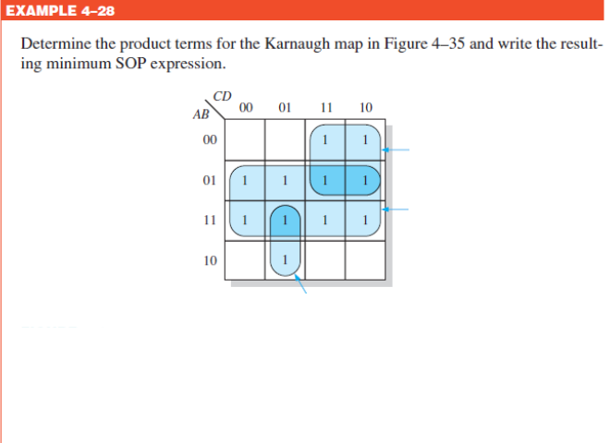
Engr.Hammad Munami

Slide 27

Engr.Hammad Munami

Slide 28

Engr.Hammad Munami

Slide 29
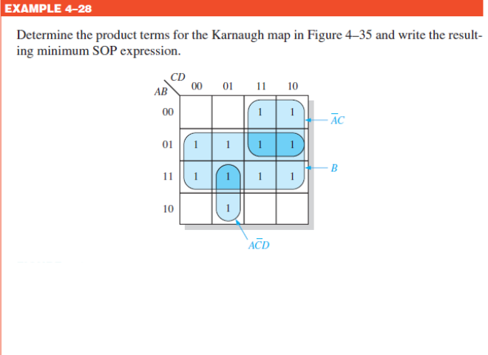
Engr.Hammad Munami

Slide 30
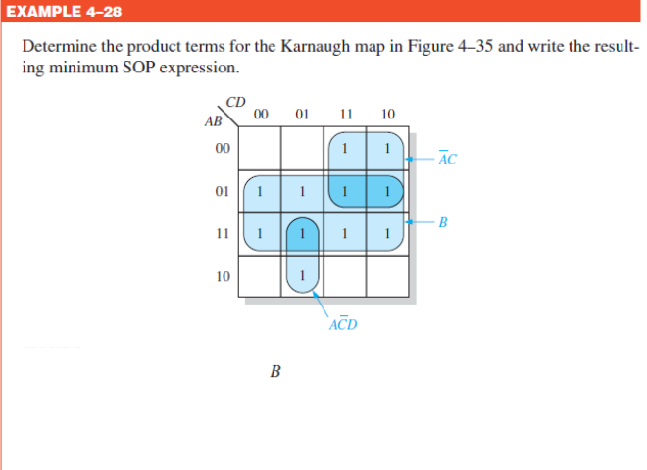
Engr.Hammad Munami

Slide 31
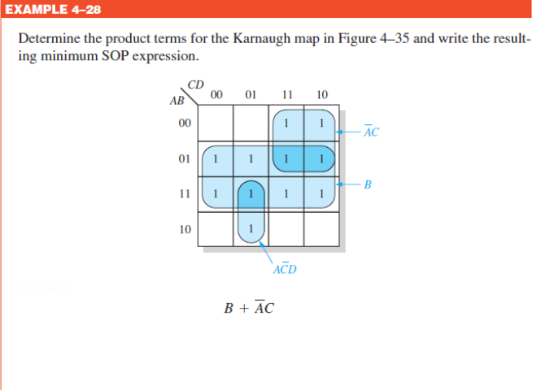
Engr.Hammad Munami

Slide 32

Engr.Hammad Munami

Slide 33
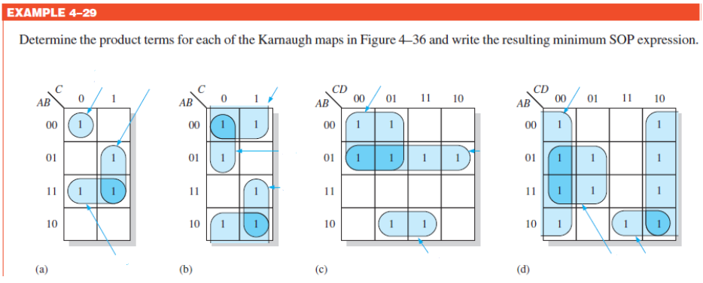
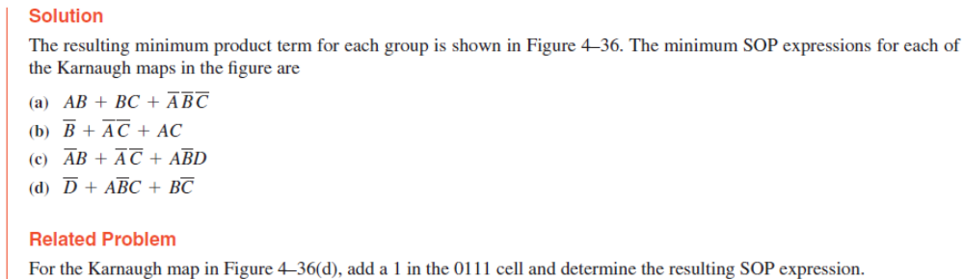
Engr.Hammad Munami

Slide 34



Engr.Hammad Munami

Slide 35

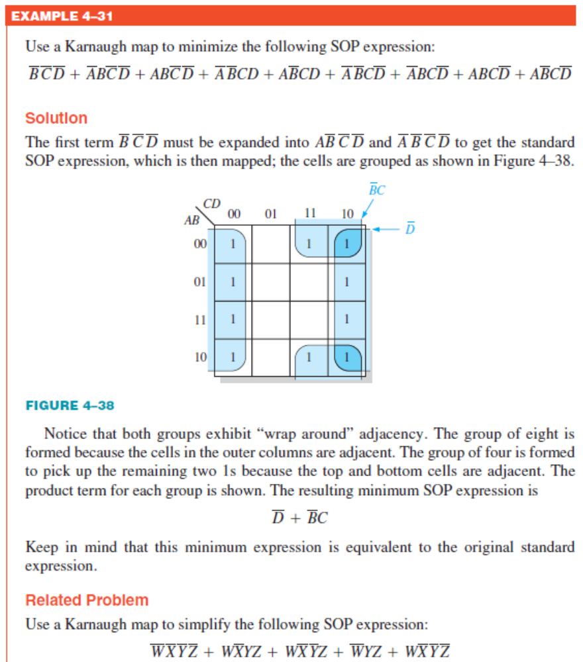
DIY
Engr.Hammad Munami

Slide 36
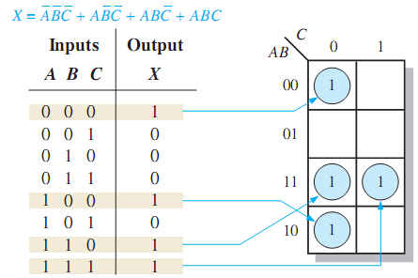
Mapping Directly from a Truth Table
A truth table gives the output of a Boolean expression for all possible input variable combinations.
An example of a Boolean expression and its truth table representation is shown in Figure:
Notice in the truth table that the output X is 1 for four different input variable combinations.
Engr.Hammad Munami

Slide 37
Mapping Directly from a Truth Table
The 1s in the output column of the truth table are mapped directly onto a Karnaugh map into the cells corresponding to the values of the associated input variable combinations.
In the figure you can see that the Boolean expression, the truth table, and the Karnaugh map are simply different ways to represent a logic function.
Engr.Hammad Munami

Slide 38
“Don’t Care” Conditions
Sometimes a situation arises in which some input variable combinations are not allowed.
For example, recall that in the BCD code, there are six invalid combinations: 1010, 1011, 1100, 1101, 1110, and 1111.
Since these unallowed states will never occur in an application involving the BCD code, they can be treated as “don’t care” terms with respect to their effect on the output.
That is, for these “don’t care” terms either a 1 or a 0 may be assigned to the output; it really does not matter since they will never occur.
Engr.Hammad Munami

Slide 39
“Don’t Care” Conditions
The “don’t care” terms can be used to advantage on the Karnaugh map.
For each “don’t care” term, an X is placed in the cell. When grouping the 1s, the Xs can be treated as 1s to make a larger grouping.
The larger a group, the simpler the resulting term will be.
Engr.Hammad Munami

Slide 40
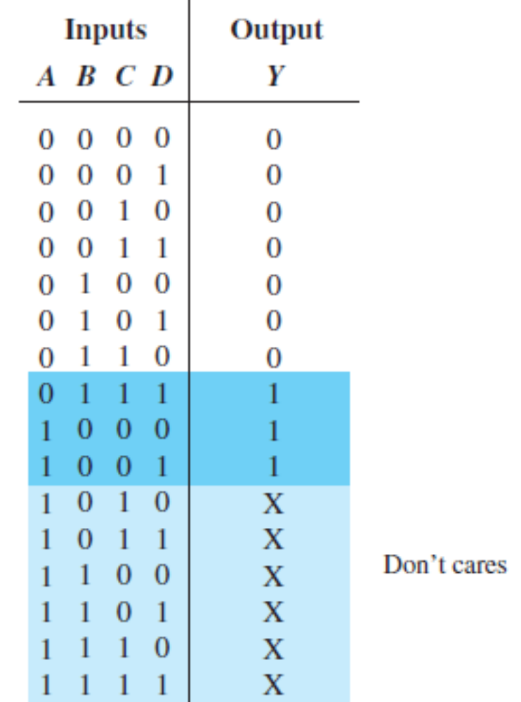
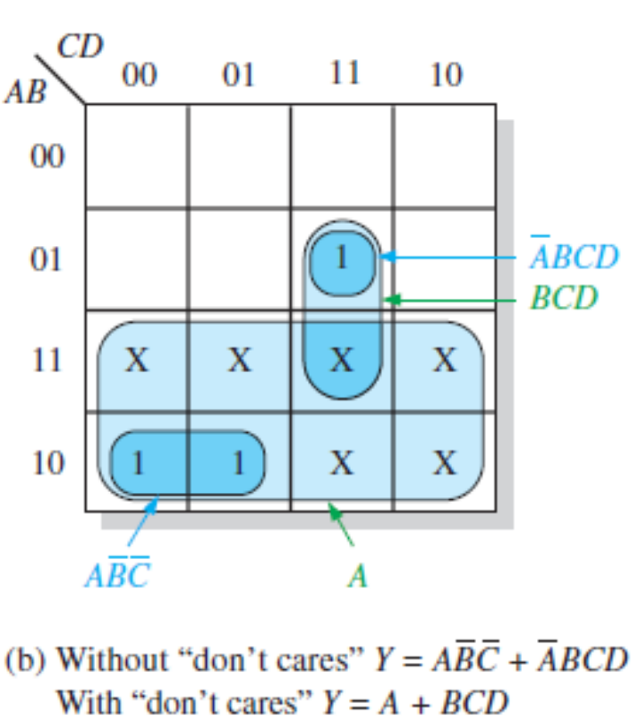
Engr.Hammad Munami

Slide 41
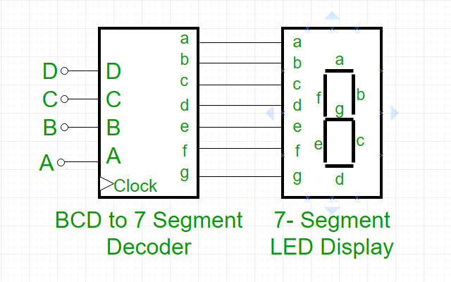
7 Segment Display
Engr.Hammad Munami

Slide 42
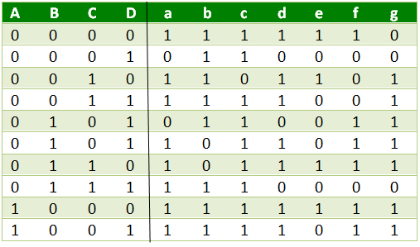
7 Segment Truth Table
Engr.Hammad Munami

Slide 43
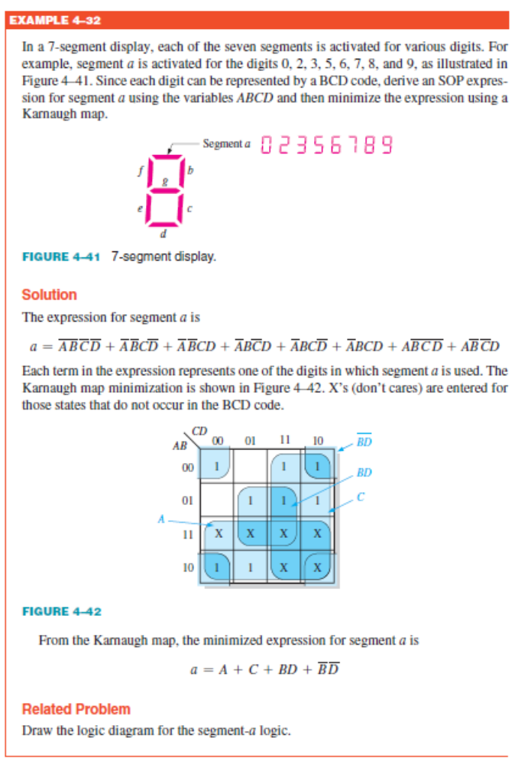
Engr.Hammad Munami

